Slide 1
Java DevCamp 2023
Girls edition

Slide 2







Agenda Workshop #1
Intro – Meet the team
Adobe
What we’re building
Setup Prerequisites
Git
Maven
Docker

Slide 3

Meet the team

Slide 4



Slide 5




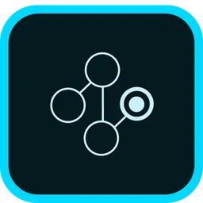

Document Cloud
Creative Cloud
Experience Cloud
Focus on digital document creation and management
Adobe's hub for creative tools and services
Drives engaging and personalized digital interactions
Adobe Target
Adobe Analytics

Slide 6

Adobe Open Internships
Java Software Engineer
C++ Software Engineer
Python Software Engineer
JavaScript Software Engineer
Machine Learning Engineer
Program Management

Slide 7
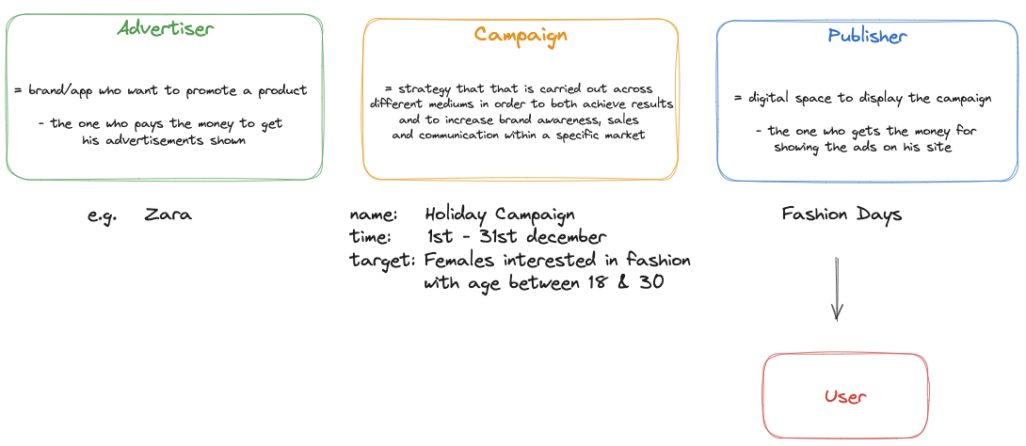
Advertising Campaign Management App flow

Slide 8
Prerequisites
IntelliJ IDEA (install link)
Git (getting started link)
Maven
Automatically installed by IntelliJ IDEA
Docker (install link)
Postman (install link)

Slide 9

Interactive tool to learn Git: https://learngitbranching.js.org/

Slide 10


Slide 11


Slide 12


Slide 13


Slide 14


Slide 15
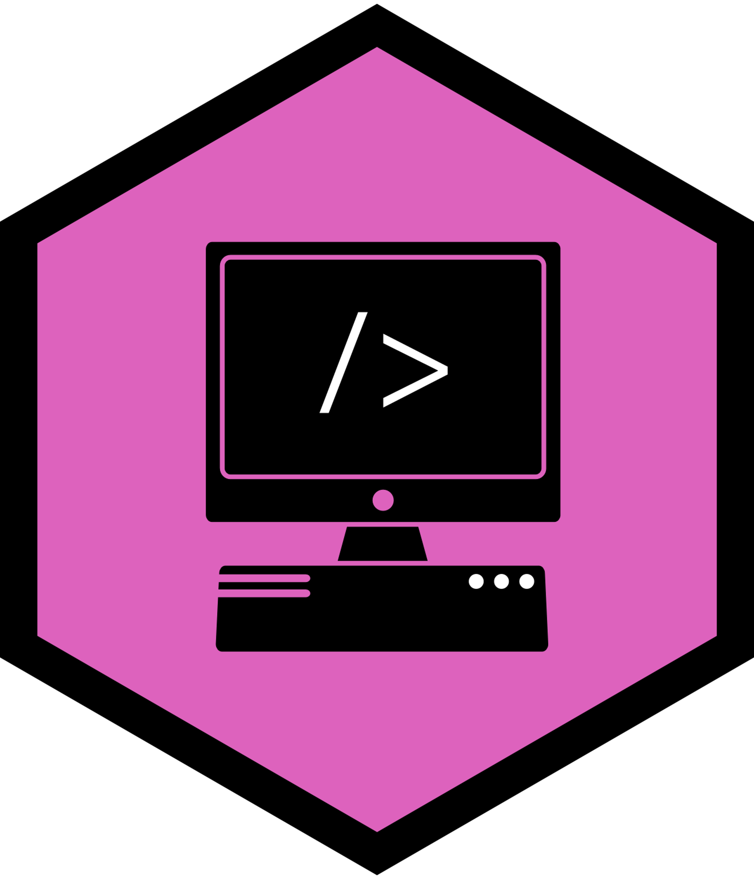

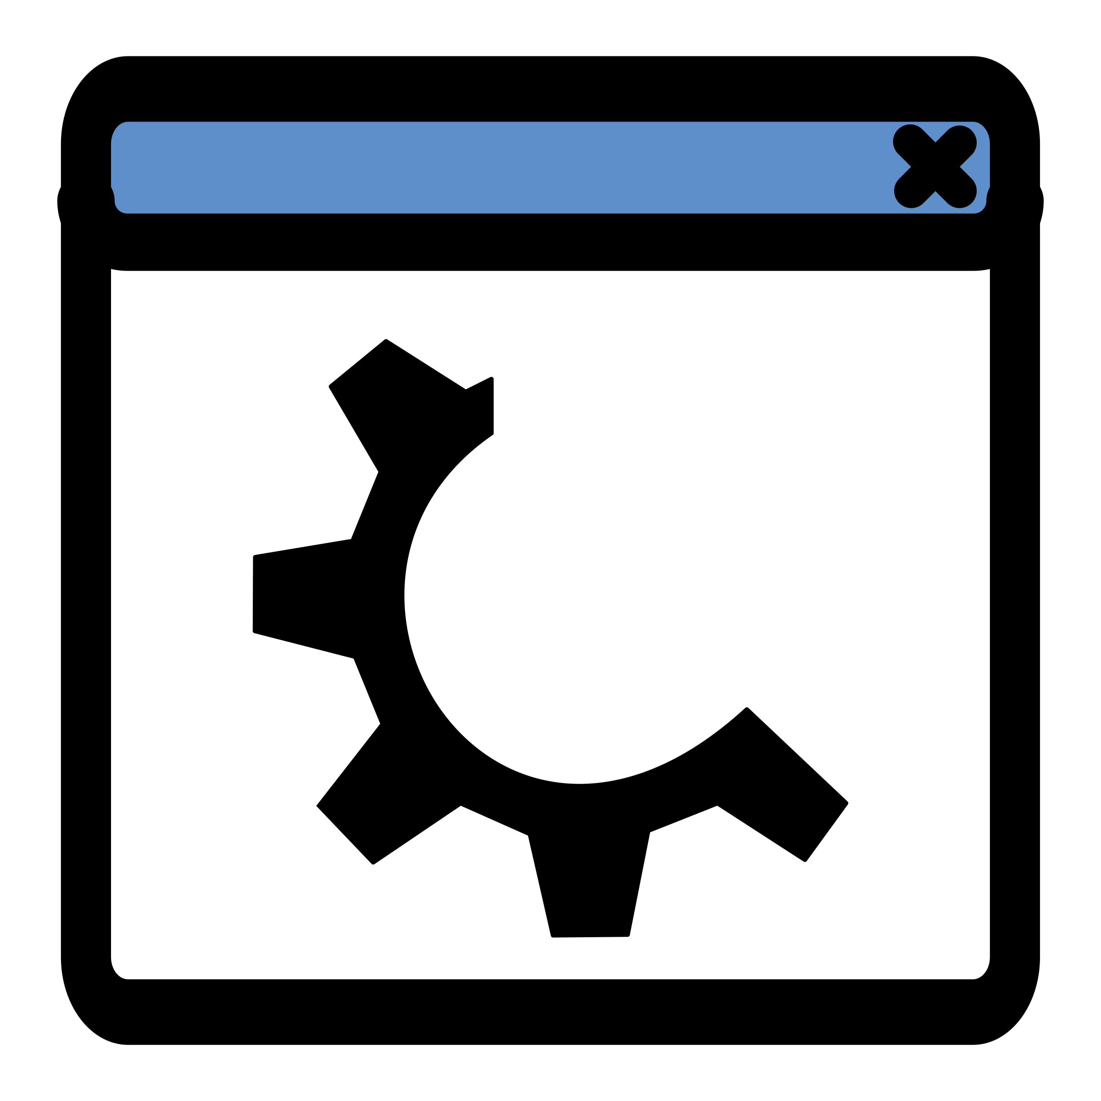


The Docker Container
configs
libs
code

Slide 16
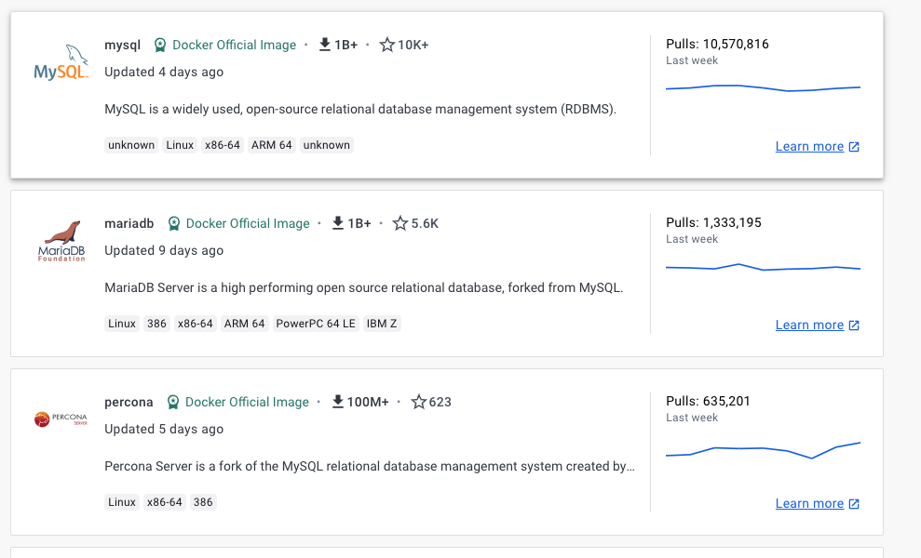
Docker Registry – image store

Slide 17
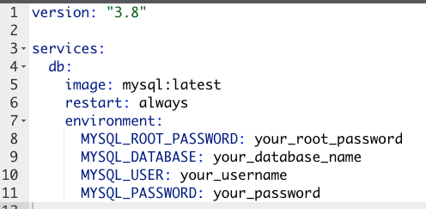
Docker Compose

Slide 18
What's coming next?

Slide 19
Workshop #2
We’ll start working on out application, getting hands on experience with Spring, Spring Boot, Maven and Jackson.
We’ll make our first call to our service using Postman

Slide 20
Closing notes
You can find all these information in the Java DevCamp 2023 GitHub repository
Please make sure you have installed all the required programs before next session
Use the feedback form if you have any feedback for this session
If you any burning questions (related or not to the sessions), please use the Ask It All form; we’ll try to go over them in the following workshops

Slide 21


